Slide 1
Assignment 4

Slide 2
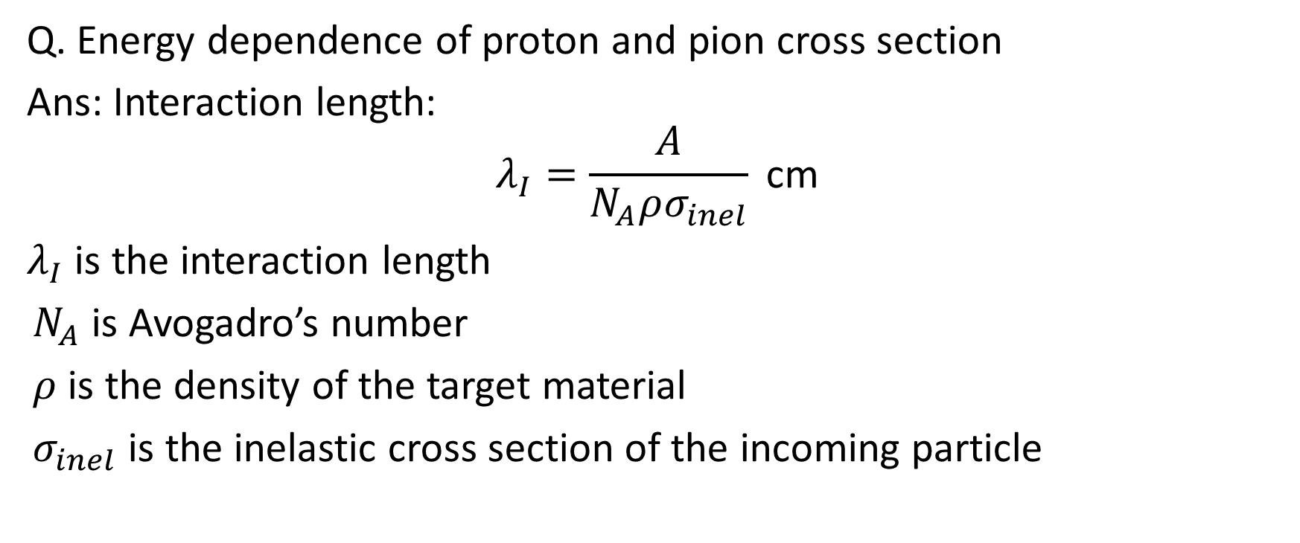
Problem 1
Q. Energy dependence of proton and pion cross section
Ans: Interaction length:
$$λ_{I}=\frac{A}{N_{A}ρσ_{inel}} \text{cm}$$
$λ_{I}$ is the interaction length
$N_{A}$ is Avogadro’s number
$ρ$ is the density of the target material
$σ_{inel}$ is the inelastic cross section of the incoming particle
(Grupen and Schwartz)

Slide 3
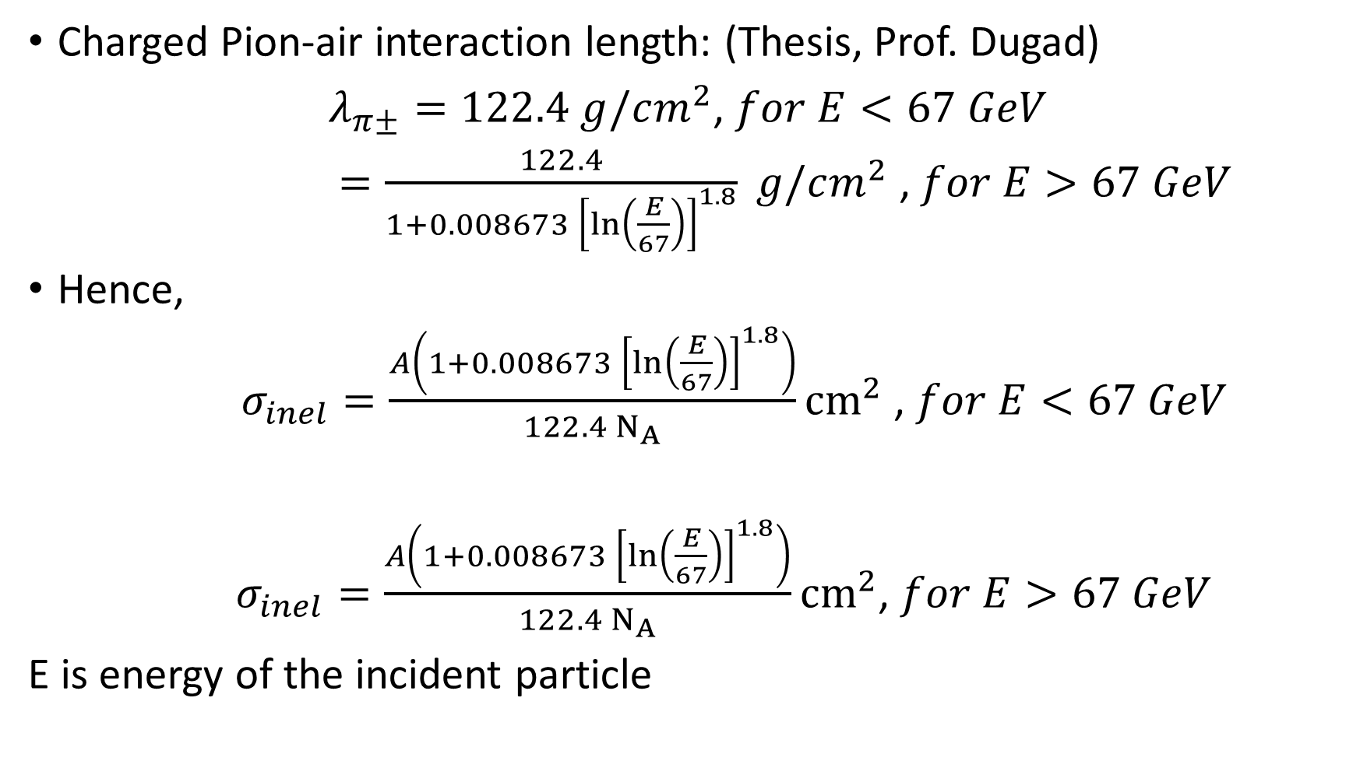
Charged Pion-air interaction length: (Thesis, Prof. Dugad)
$λ_{π±}=122.4 g/cm^{2}$, $for E<67 GeV$
$=\frac{122.4}{1+0.008673 {\left[\ln\left(\frac{E}{67}\right)\right]}^{1.8}} g/cm^{2}$ , $for E>67 GeV$
Hence,
$σ_{inel}=\frac{A\left(1+0.008673 {\left[\ln\left(\frac{E}{67}\right)\right]}^{1.8}\right)}{122.4 N_{A}}{cm}^{2}$ , $for E<67 GeV$
$σ_{inel}=\frac{A\left(1+0.008673 {\left[\ln\left(\frac{E}{67}\right)\right]}^{1.8}\right)}{122.4 N_{A}}{cm}^{2}$, $for E>67 GeV$
E is energy of the incident particle

Slide 4
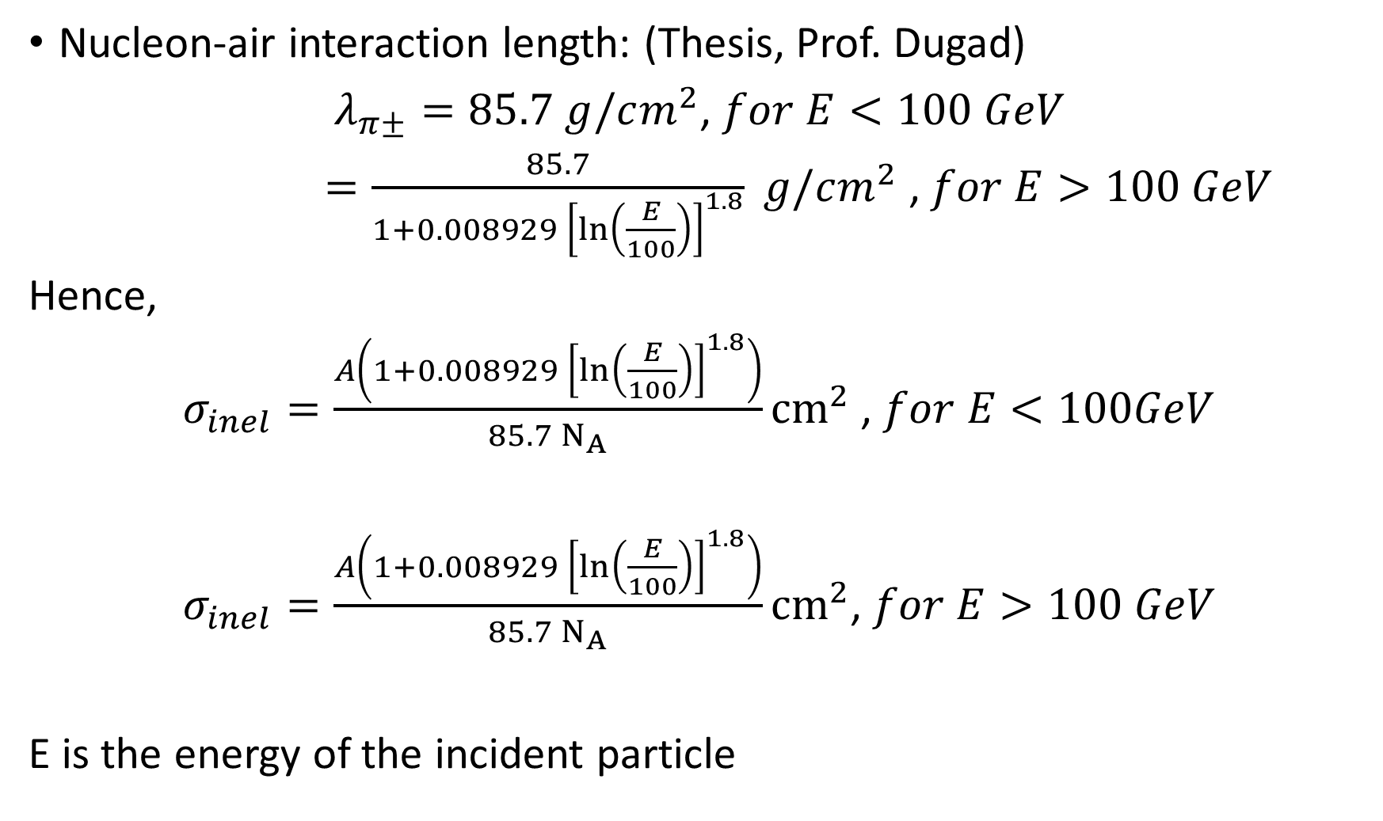
Nucleon-air interaction length: (Thesis, Prof. Dugad)
$λ_{π±}=85.7 g/cm^{2}$, $for E<100 GeV$
$=\frac{85.7}{1+0.008929 {\left[\ln\left(\frac{E}{100}\right)\right]}^{1.8}} g/cm^{2}$ , $for E>100 GeV$
Hence,
$σ_{inel}=\frac{A\left(1+0.008929 {\left[\ln\left(\frac{E}{100}\right)\right]}^{1.8}\right)}{85.7 N_{A}}{cm}^{2}$ , $for E<100GeV$
$σ_{inel}=\frac{A\left(1+0.008929 {\left[\ln\left(\frac{E}{100}\right)\right]}^{1.8}\right)}{85.7 N_{A}}{cm}^{2}$, $for E>100 GeV$
E is the energy of the incident particle

Slide 5
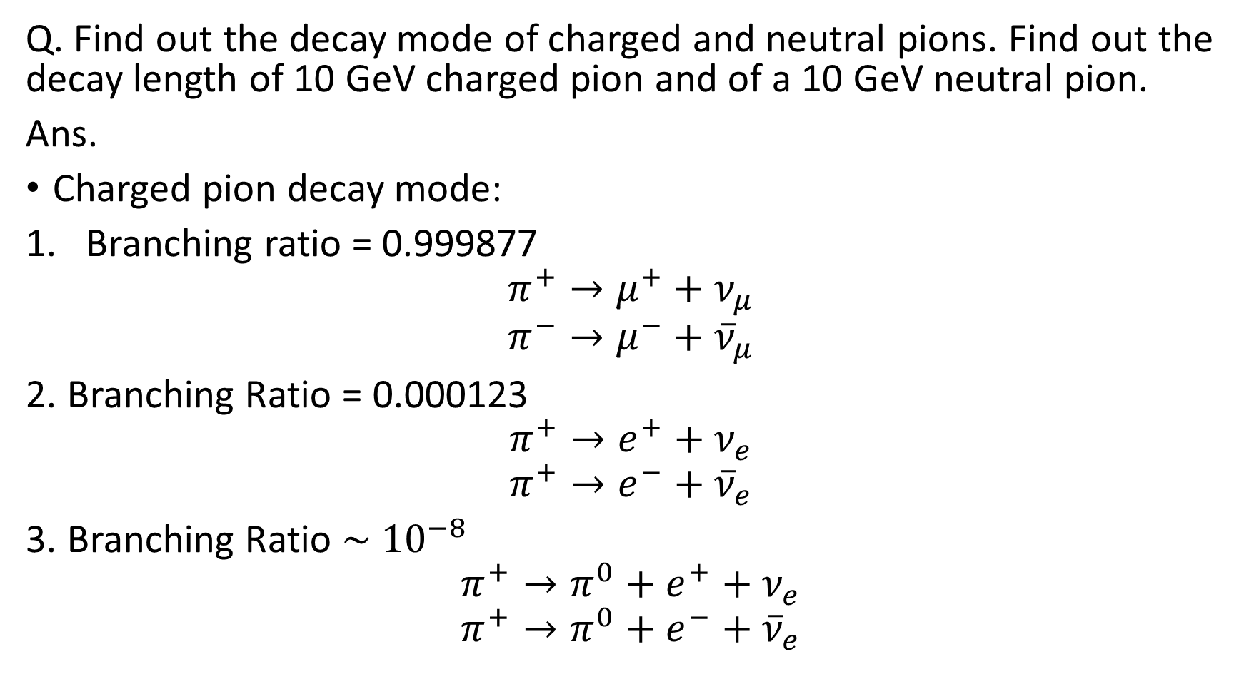
Problem 3
Q. Find out the decay mode of charged and neutral pions. Find out the decay length of 10 GeV charged pion and of a 10 GeV neutral pion.
Ans.
Charged pion decay mode:
Branching ratio = 0.999877
$$π^{+}→μ^{+}+ν_{μ}$$
$$π^{−}→μ^{−}+{\overline{ν}}_{μ}$$
2. Branching Ratio = 0.000123
$$π^{+}→e^{+}+ν_{e}$$
$$π^{+}→e^{−}+{\overline{ν}}_{e}$$
3. Branching Ratio $\sim {10}^{−8}$
$$π^{+}→π^{0}+e^{+}+ν_{e}$$
$$π^{+}→π^{0}+e^{−}+{\overline{ν}}_{e}$$

Slide 6
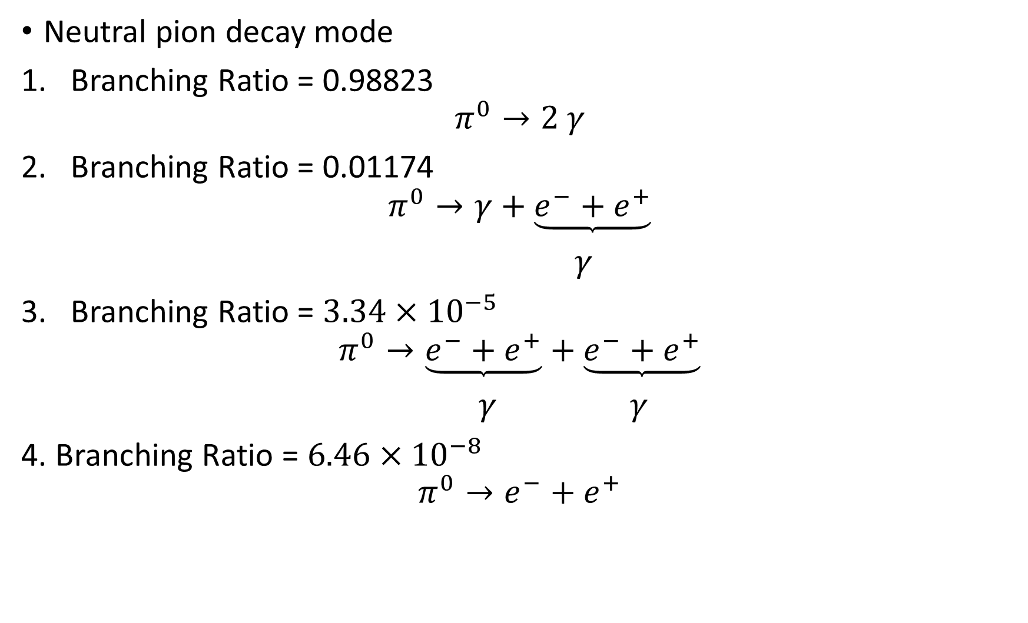
Neutral pion decay mode
Branching Ratio = 0.98823
$$π^{0}→2 γ$$
Branching Ratio = 0.01174
$$π^{0}→γ+\underbrace{e^{−}+e^{+}}$$
$γ$
Branching Ratio = $3.34×{10}^{−5}$
$$π^{0}→\underbrace{e^{−}+e^{+}}+\underbrace{e^{−}+e^{+}}$$
$γ$ $γ$
4. Branching Ratio = $6.46×{10}^{−8}$
$$π^{0}→e^{−}+e^{+}$$

Slide 7
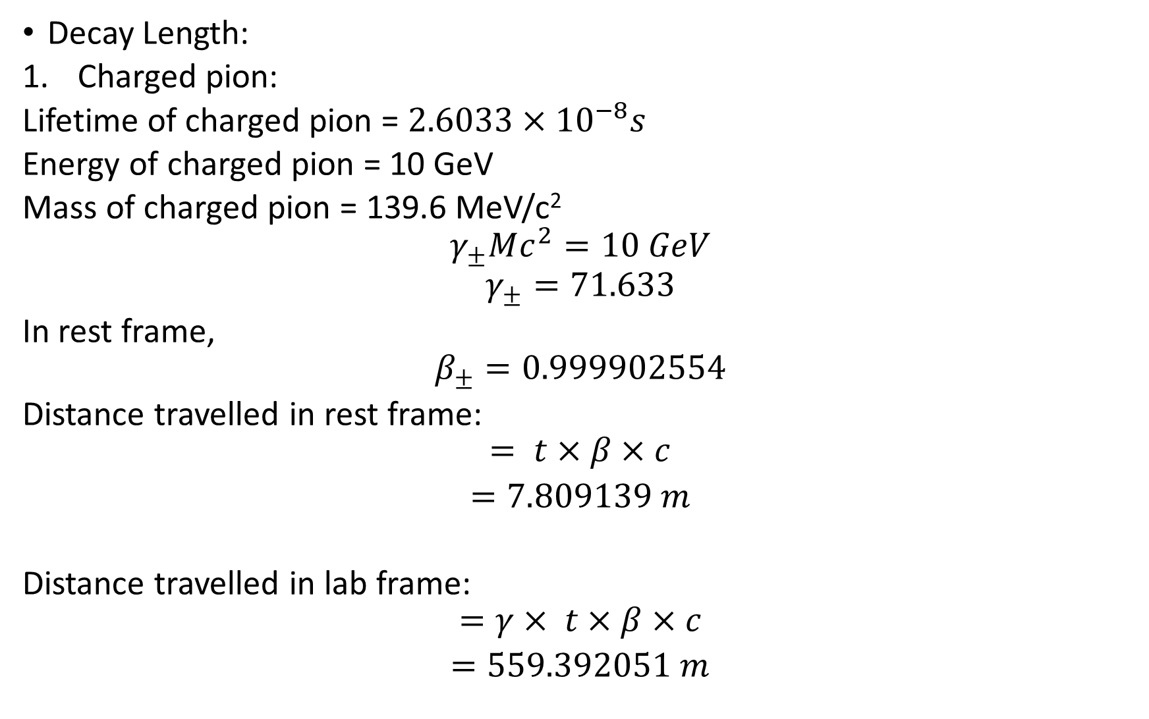
Decay Length:
Charged pion:
Lifetime of charged pion = $2.6033×{10}^{−8}s$
Energy of charged pion = 10 GeV
Mass of charged pion = 139.6 MeV/c²
$$γ_{±}Mc^{2}=10 GeV$$
$$γ_{±}=71.633$$
In rest frame,
$$β_{±}=0.999902554$$
Distance travelled in rest frame:
$$= t×β×c$$
$=7.809139 m$
Distance travelled in lab frame:
$$=γ× t×β×c$$
$=559.392051 m$

Slide 8
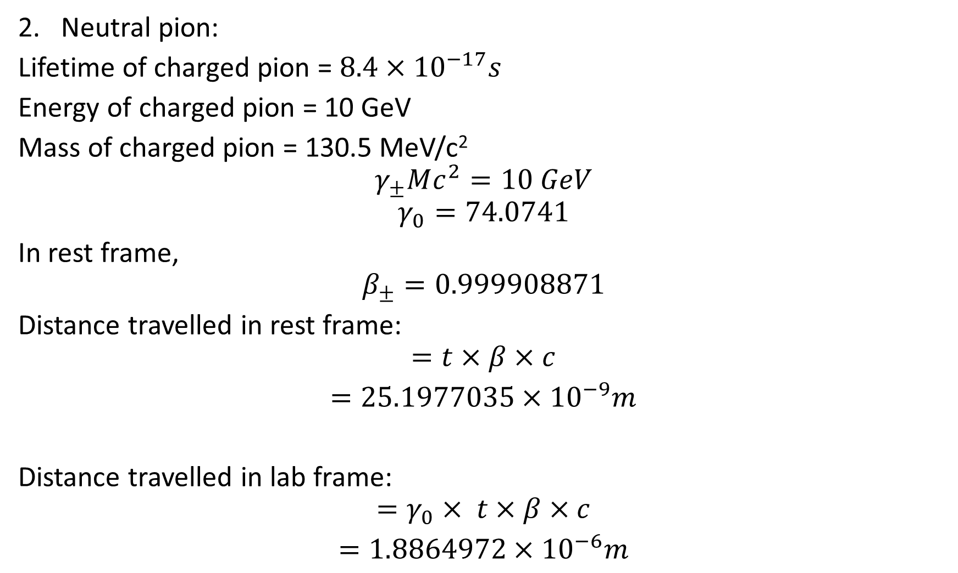
2. Neutral pion:
Lifetime of charged pion = $8.4×{10}^{−17}s$
Energy of charged pion = 10 GeV
Mass of charged pion = 130.5 MeV/c²
$$γ_{±}Mc^{2}=10 GeV$$
$$γ_{0}=74.0741$$
In rest frame,
$$β_{±}=0.999908871$$
Distance travelled in rest frame:
$$=t×β×c$$
$=25.1977035×{10}^{−9}m$
Distance travelled in lab frame:
$$=γ_{0}× t×β×c$$
$=1.8864972×{10}^{−6}m$

Slide 9
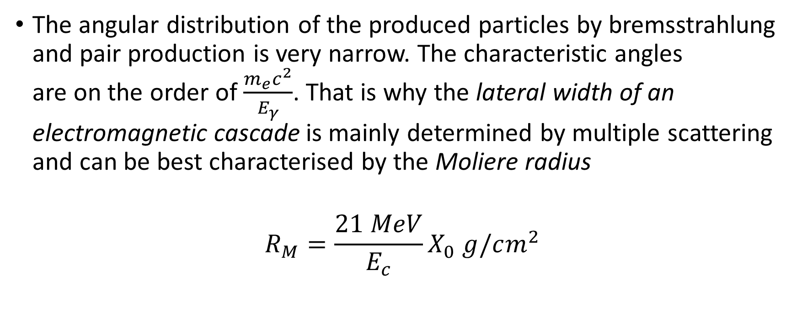
Moliere Radius (Grupen)
The angular distribution of the produced particles by bremsstrahlung and pair production is very narrow. The characteristic angles are on the order of $\frac{m_{e}c^{2}}{E_{γ}}$. That is why the lateral width of an electromagnetic cascade is mainly determined by multiple scattering and can be best characterised by the Moliere radius
$$R_{M}=\frac{21 MeV}{E_{c}}X_{0} g/cm^{2}$$

Slide 10
About 95% of the shower energy is contained in a cylinder around the shower axis whose radius is R(95%) = 2 R_{M}, almost independently of the energy of the incident particle.
The dependence of the containment radius on the material is taken into account by the critical energy and radiation length.

